Slide 1
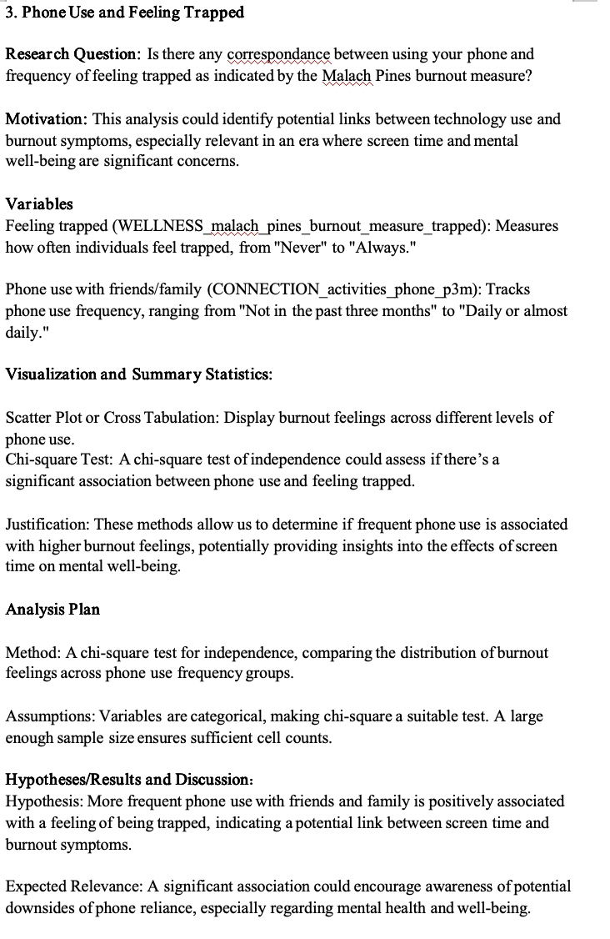
Original Work

Slide 2
The part which need to be modified
Analysis Plan
Method: A chi-square test for independence, comparing the distribution of burnout feelings across phone use frequency groups.
Assumptions: Variables are categorical, making chi-square a suitable test. A large enough sample size ensures sufficient cell counts.

Slide 3
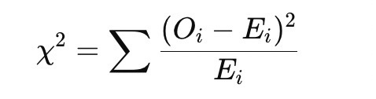
What I did
Null Hypothesis(H0): Phone use frequency and feelings of being trapped are independent (no relationship).
Alternative Hypothesis (HA): Phone use frequency and feelings of being trapped are not independent (there is a relationship).
Formula：
I explain the Chi-square test in more detail, including pointing out the advantages of the Chi-square test and identifying null and alternative hypotheses
Oi is the observed frequency
Ei is the expected frequency. It's calculated
X^2Value and p-value to determine whether to reject the null hypothesis.
If the p-value is less than 0.05, reject the null hypothesis (H0) and conclude that there is a significant association between phone use and feelings of being trapped.
If the p-value is greater than 0.05, fail to reject the null hypothesis (H0) and conclude that there is no sufficient evidence to suggest a relationship.

Slide 4
Why I did not change the analysis method
The chi-square test is designed for categorical variables.
Variables：
Feeling trapped: A categorical variable measuring frequency (e.g., "Never" to "Always").
Phone use frequency: A categorical variable (e.g., "Not in the past three months" to "Daily or almost daily").
Since both variables are categorical, the chi-square test is a valid choice.

